Slide 1

Distributed File System
Ishan Gaikwad

Slide 2

What is a file system?
Persistent stored data sets.
Hierarchic name space visible to all processes.
API with the following characteristics:
Share date between users , with access control.
Access and update operations on persistently stored data sets.
Sequential access model.
Concurrent access:- Only for read-only access.
Other features:- mountable file stores

Slide 3
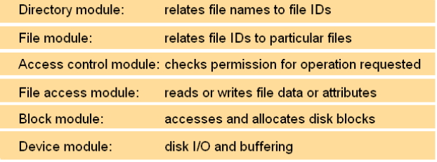
File system modules

Slide 4
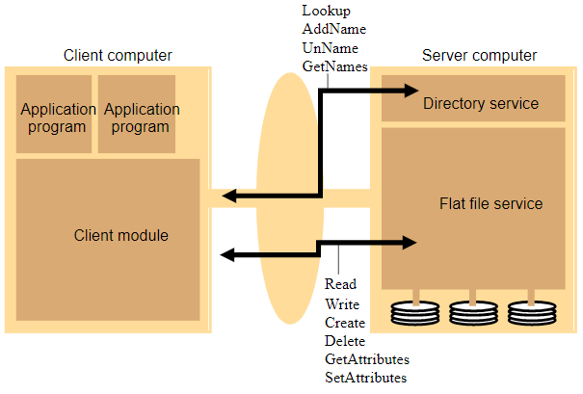
File Service Architecture

Slide 5
DFS Overview
A distributed implementation of the time-sharing model of a file system, where multiple users share files and storage resources.
DFS manages set of dispersed storage devices.
Storage space managed by DFS is composed of different, remotely located, smaller storage spaces.

Slide 6

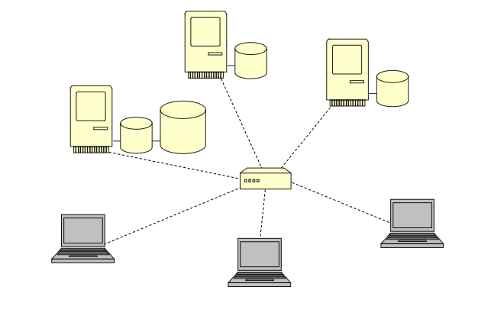
DFS Architecture
In DFS files can be store at any machine and the computation can be performed at any machine.
When client machine needs to access file stored on server machine , the server machine performs the necessary operation and return data.

Slide 7
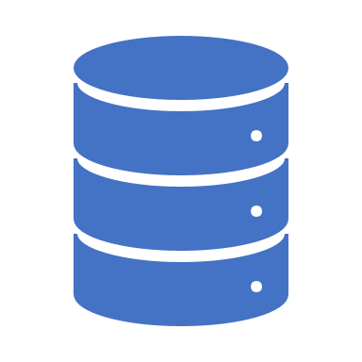
Why Distribute?
Sharing files with other users.
Others can access your files.
You can have access to files you wouldn’t regularly have access to.
Keeping files available for yourself on more than one computer.
Small amount of local resources.
High failure rate of local resources.

Slide 8
DFS Structure
Service – Software module which runs on one or more machines and provides a particular type of function to a prior unknown clients.
Server – Service software running on a single machine through which clients can request and access files.
Client – Process that can invoke a service using set of operations that forms its client interface. The interface for a file service is formed by a set of file operations such as list, read, write, view, etc.
There are two important goals of file system:-
Network Transparency
High availability

Slide 9

Network (Access) Transparency
Users should be able to access files over a network as easily as if the files were stored locally.
Users should not have to know the physical location of a file to access it.
Convenient way to share data.
File name does not need to be changed when the file’s physical storage location changes.

Slide 10
High Availability
Files should be easily and quickly accessible.
The number of users, system failures or other consequences of distribution shouldn’t compromise the availability.

Slide 11
Performance
Most important performance measurement of a DFS:
Amount of time needed to satisfy service requests.
Typical performance constraints:
Conventional file system (local drives):
Disk-access time.
Small amount of CPU-processing time.
DFS:
Additional overhead due to the distributed structure
Includes:
Time to deliver the request to a server.
Time to deliver the response to the client.

Slide 12
Conclusion
Reliable, Scalable and performant filesystem.
Open architecture and Protocols.
But
does not handle dynamic addition/removal of servers.
Does not provide the kind of access control and security that a VO might need.

Slide 13
References
“File distribution method, file distribution system, the master server, and file distribution program.” (2011).
Depardon, B., Le Mahec, G. and Séguin, C., 2013. Analysis of six distributed file systems.
https://iopscience.iop.org/article/10.1088/1742-6596/608/1/012039/pdf
https://www.webopedia.com/TERM/D/distributed_file_system.html
https://docs.microsoft.com/en-us/windows/win32/dfs/distributed-file-system-dfs-functions

